Slide 1
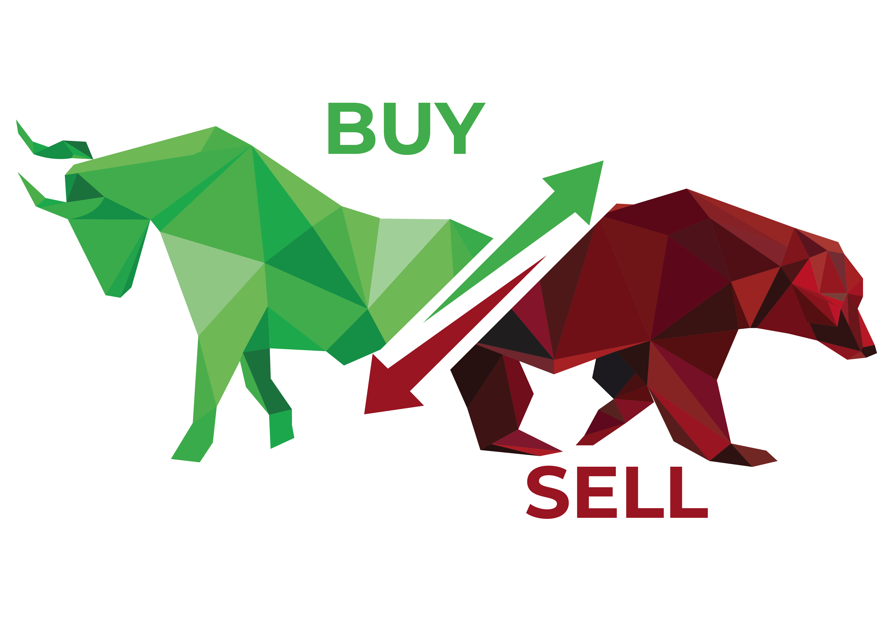

Twitter Sentiment Analysis on Stocks
Ayeesha Siddikka

Slide 2
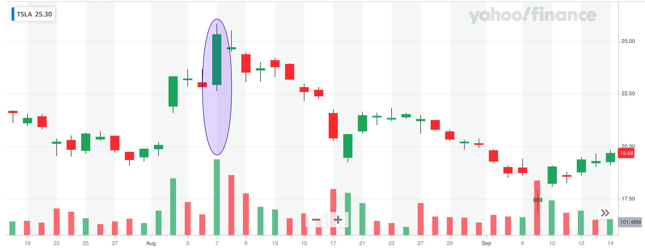
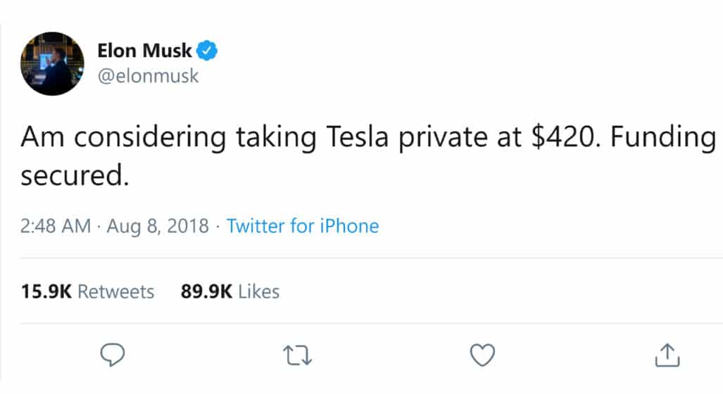
Impact of twitter in stock market
After Elon Musk’s tweet on Aug 2018 the stock price went up by ~17% on the same day

Slide 3
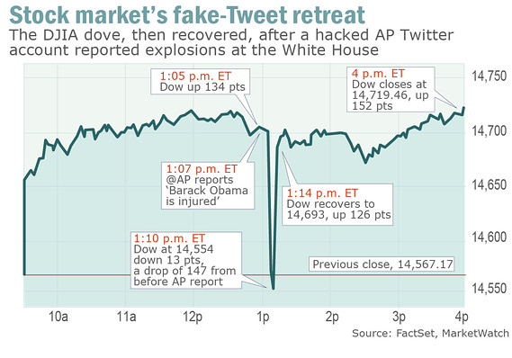
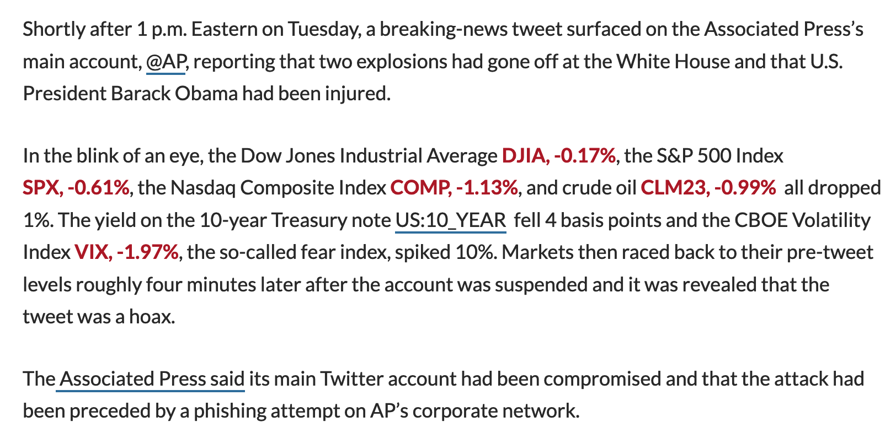
Impact of twitter in stock market
Source: https://www.marketwatch.com/story/twitter-trading-influence-laid-bare-by-fake-tweet-2013-04-23

Slide 4
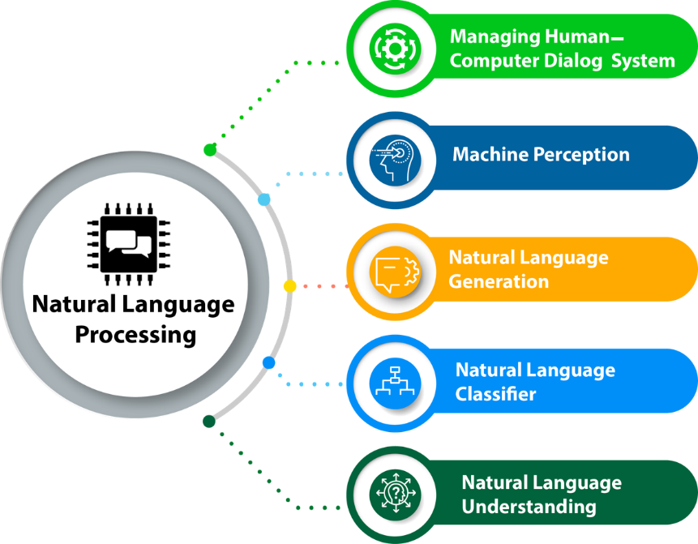
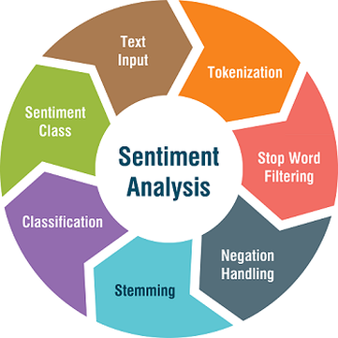
How to analyze the impact of tweets?

Slide 5
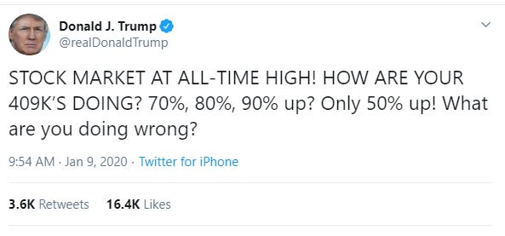

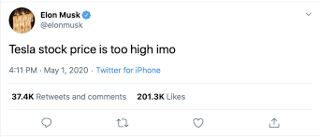
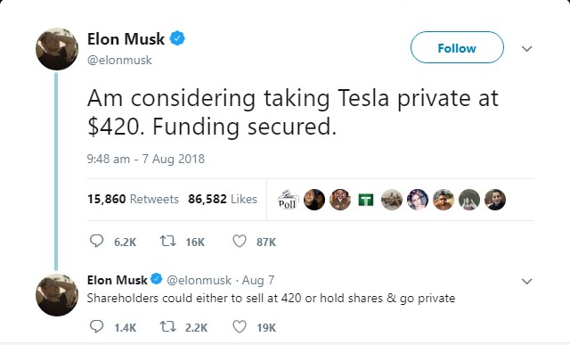
Approach
Labelled Tweets
NLP Model
Sentiment

Slide 6
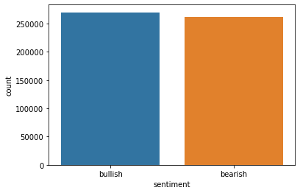
Distribuition of data
Number of bullish and bearish tweets in the dataset

Slide 7
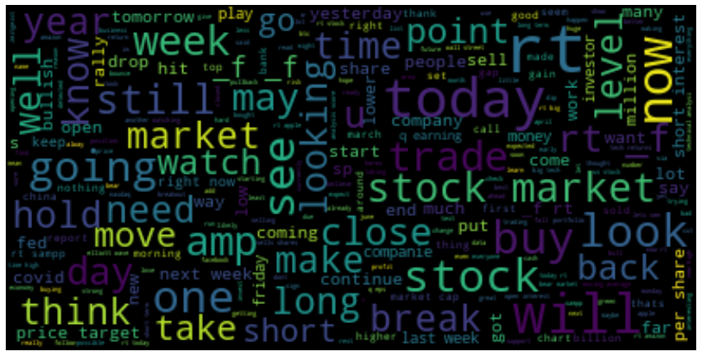
Wordcloud

Slide 8
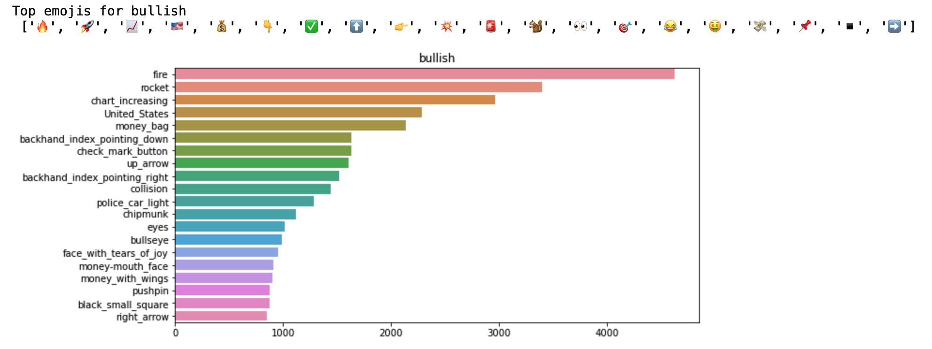
Emojis in tweet sentiment

Slide 9
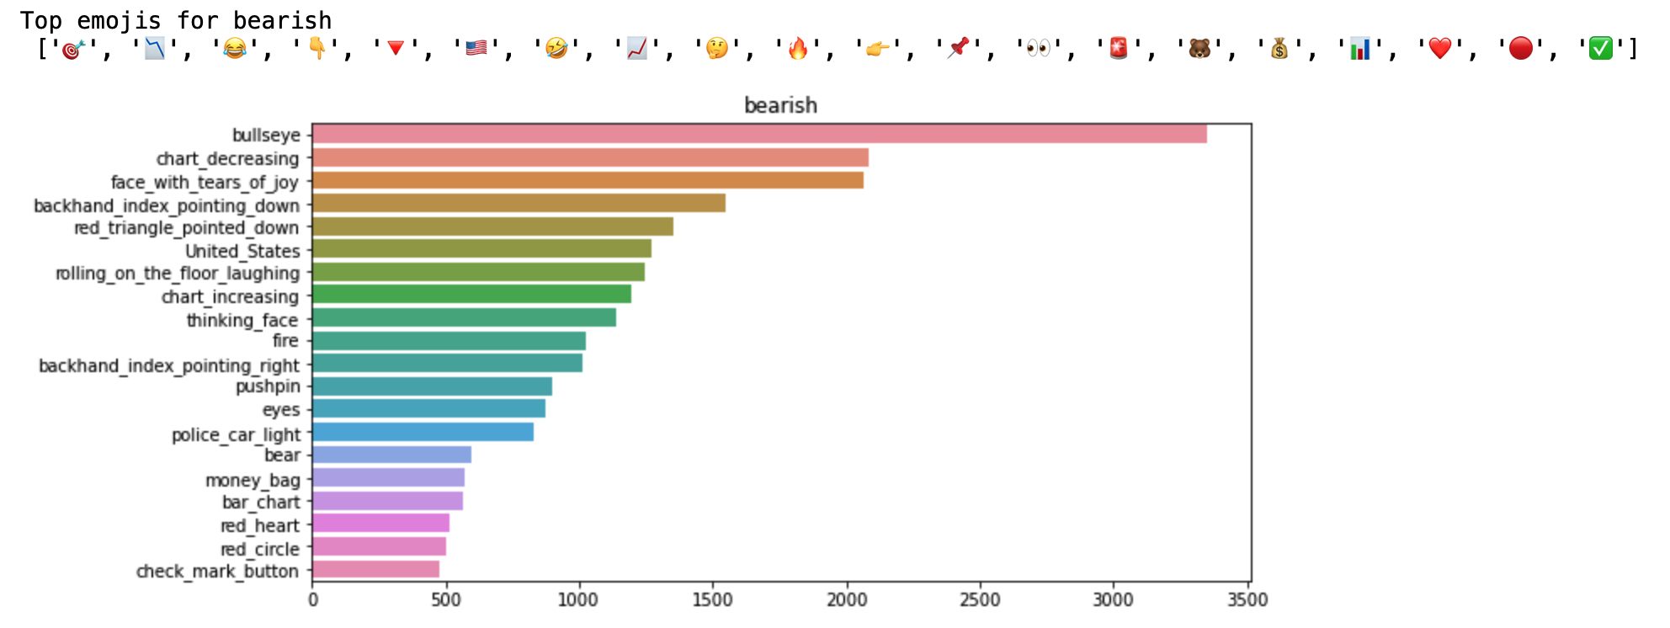
Emojis in tweet sentiment

Slide 10
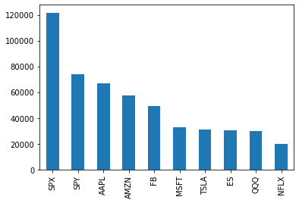
Top 10 stocks / index

Slide 11
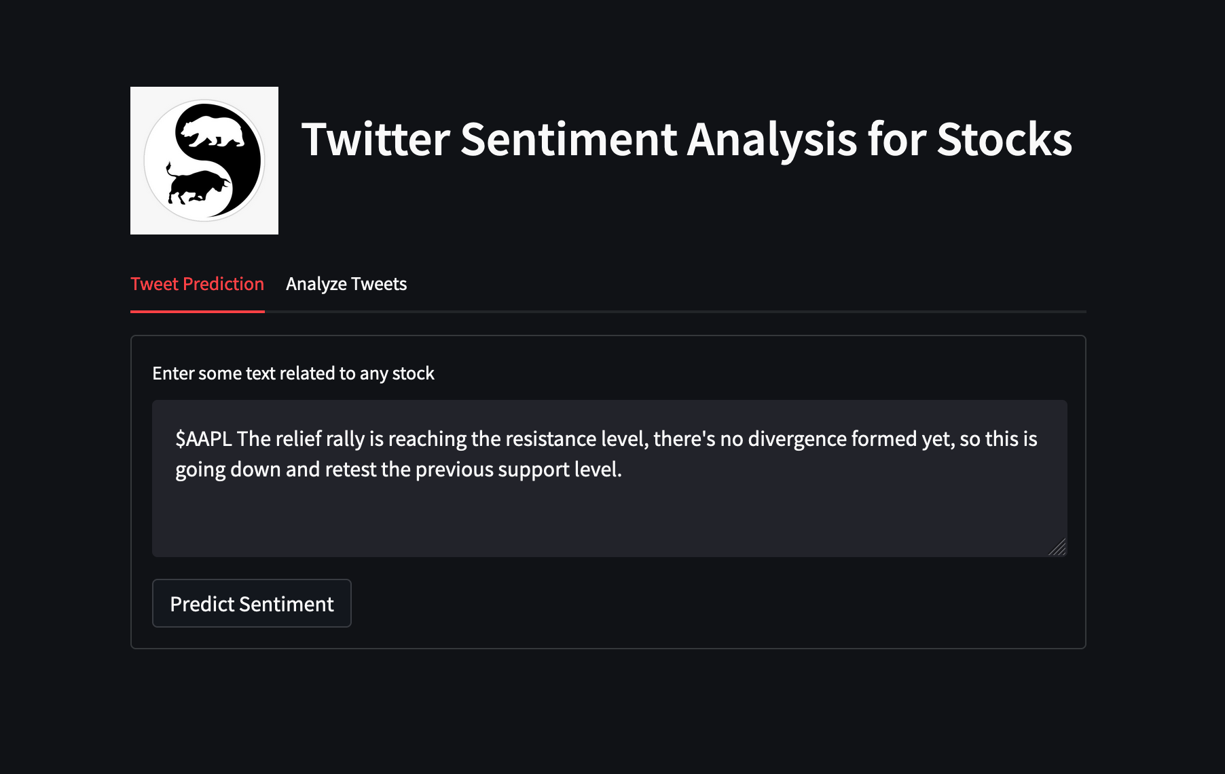

Slide 12
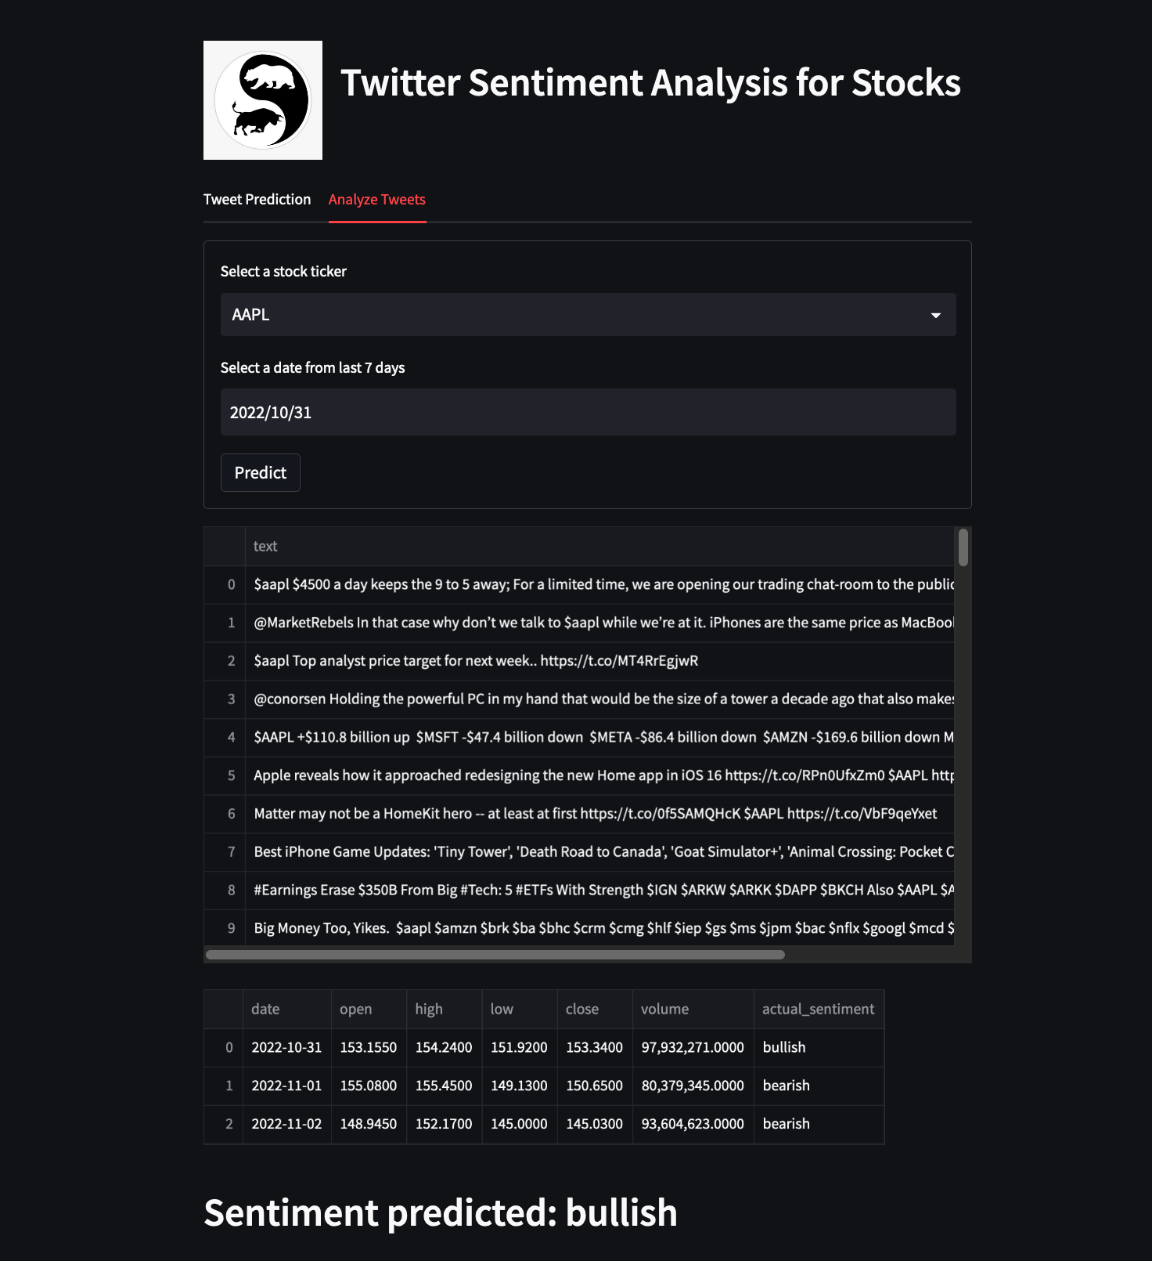
http://localhost:8501/

Slide 13
Area of improvements
Due to lack of manually labelled dataset, I used pre-trained BERT model to label dataset, where as a manually labelled dataset could have been better
Accuracy of the model can be further improved by intensive preprocessing of the tweets
Transformer models like BERT can be used to improve the f1 score of the sentiments

Slide 14

Q&A

Slide 15
Thank you

